Slide 1


SAE NIS EFFI-CYCLE >>>Drive The Future<<<
Power Enhancement Season
CAE Presentation
21028
INVINCIBLES 5.0

Slide 2
Content
Vehicle Design
Impact Load Calculation
FE Modelling and CAE Analysis of Frame
FE Modelling and CAE Analysis of Hard-Points
Result Comparison and Optimization Details

Slide 3
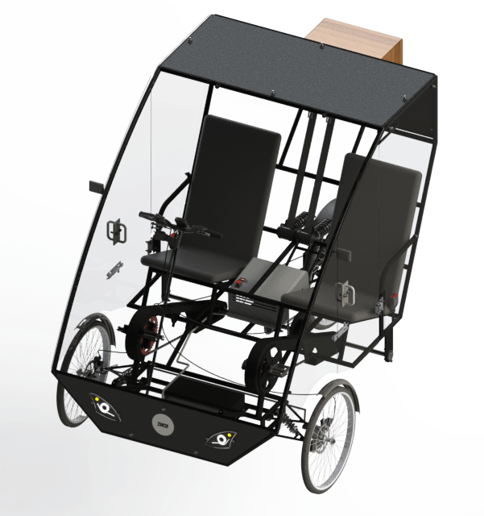
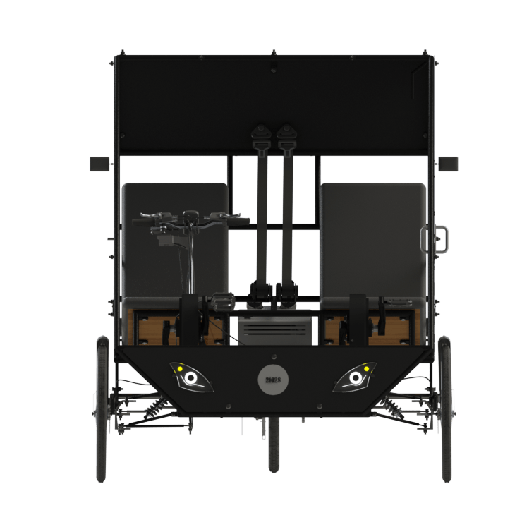
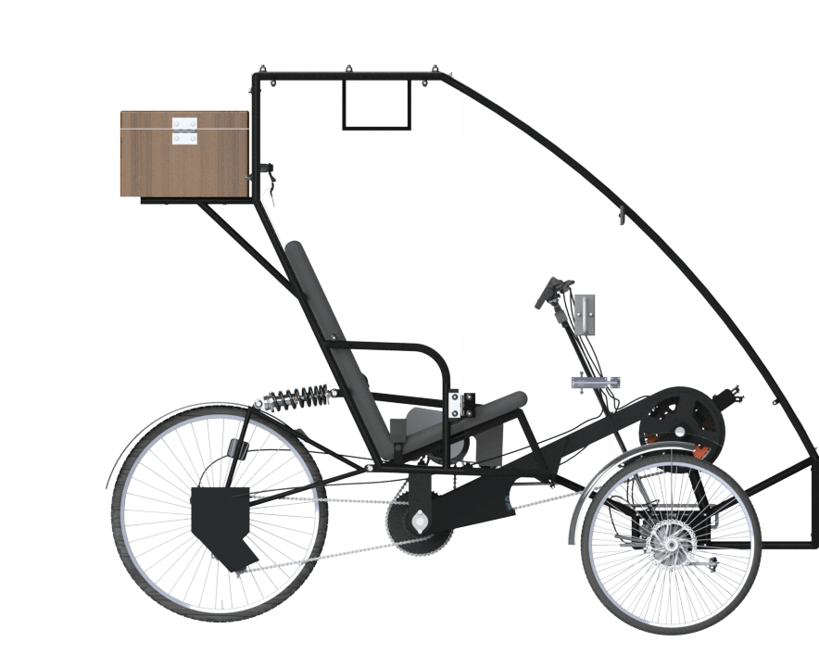
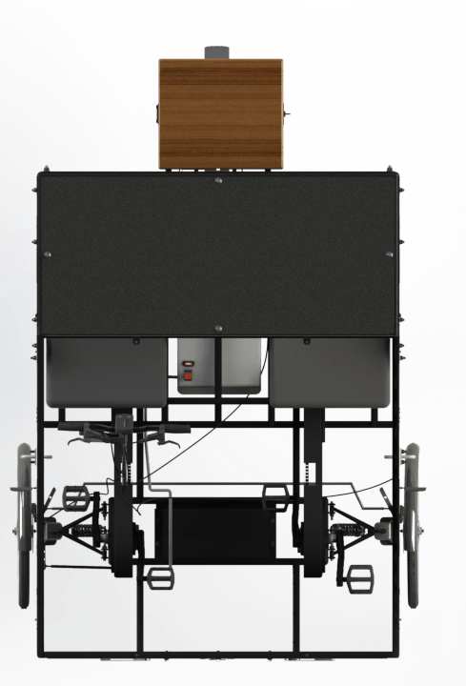
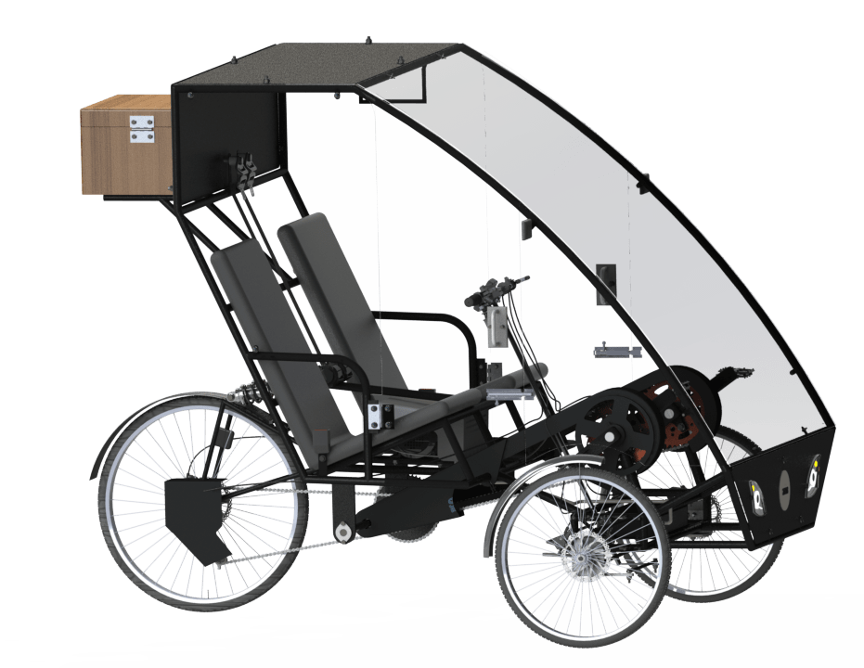
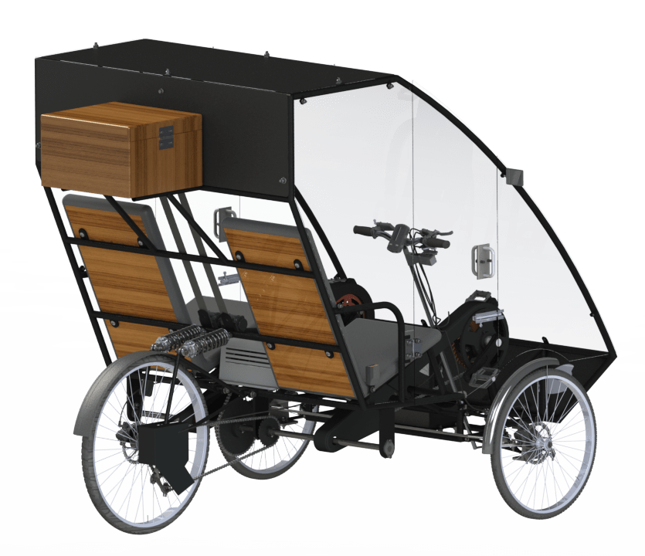
Vehicle Design
Page 1.1

Slide 4
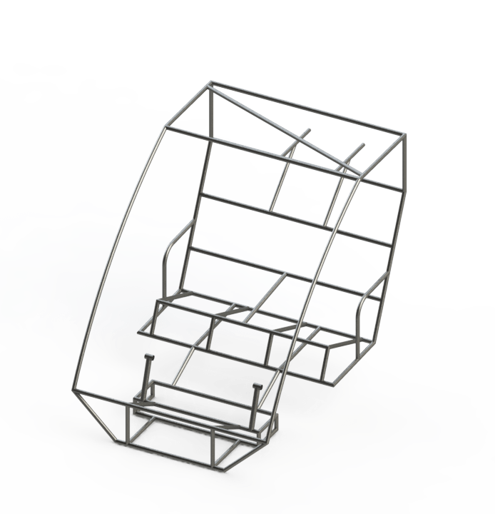
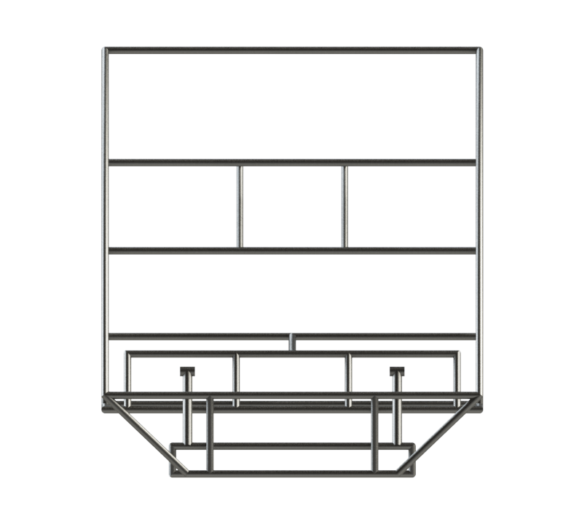
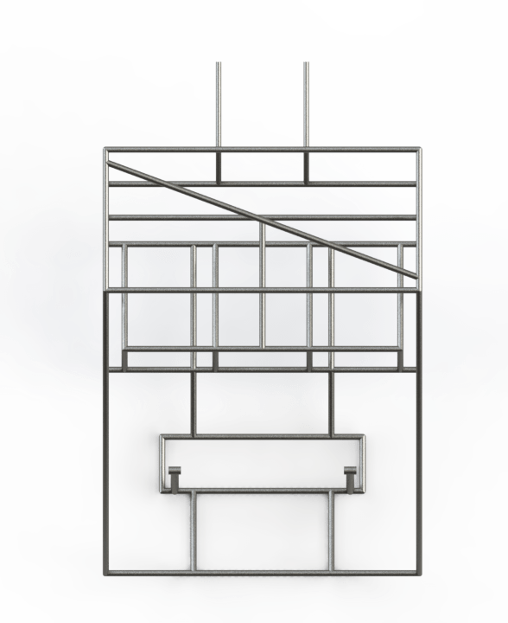
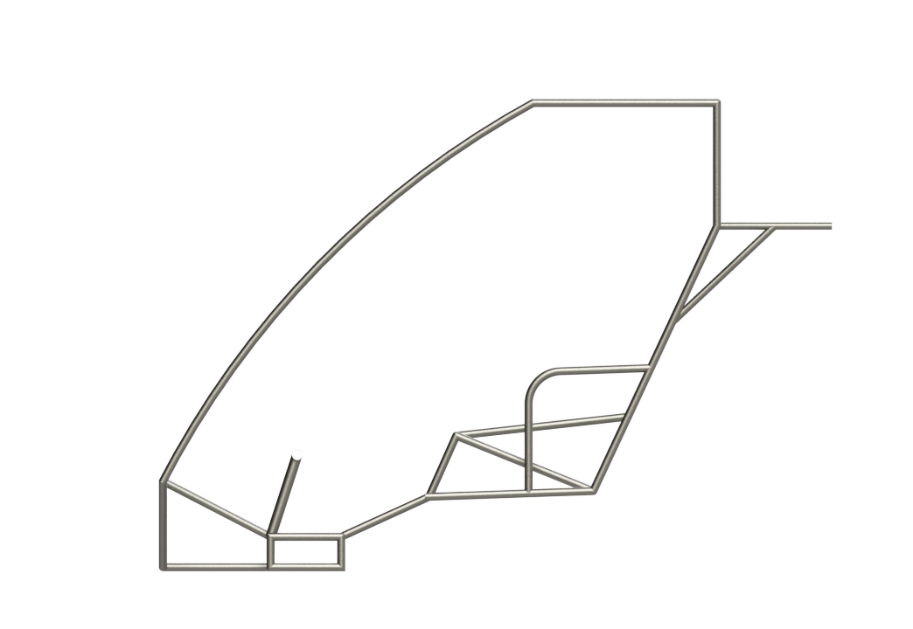
Chassis Design
Isometric
Front
Side
Top
Page 1.2

Slide 5
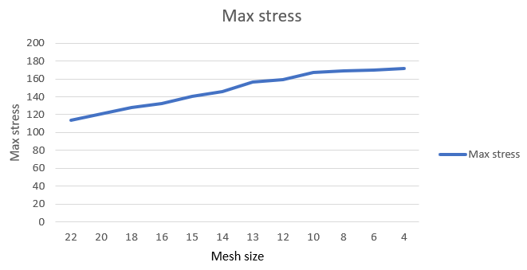
Impact Load Calculation
APPROACH
An iterative approach was undertaken to find the Equivalent Stress, Strain , Total deformation, Factor of Safety, Fatigue life and FoS of the Efficycle frame. To obtain precise results the mesh size was decided by performing repetitive analyses, on the same model with each successive analysis having a smaller element size, until the results were similar in magnitude. The following graph (fig.1) denotes the FoS against mesh element size. Since, the FoS results for 8mm and 10mm element size were similar, the succeeding analyses were performed on 8mm quadratic mesh element size.
To decide the magnitude of force acting on the chassis, the only reliable input parameters were:
i) Acceleration of the Vehicle: The force acting on the chassis is directly proportional to the acceleration of the vehicle (before impact - accumulating kinetic energy) or deceleration after impact (conversion of kinetic energy into deformation - depends on impact time). In any case, the acceleration was divided into ‘G forces’ and was decided based on the application of force.
ii) Impact Time: The impact time was assumed to be around 0.3 seconds based on different crash tests and real life scenarios in the automotive province.
Page 2

Slide 6
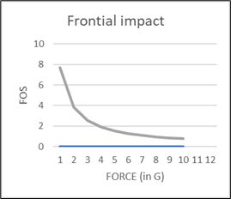
FRONT IMPACT
For the boundary conditions of the front impact test, the suspension mounting members on the chassis were fixed and force was applied on front face members of the chassis.
ASSUMPTIONS:
The vehicle undergoes head-on collision with a stationary rigid object of infinite mass.
The acceleration (a) of the vehicle is 3G based on relative crash tests.
The impact time (t) of the collision is around 0.3 seconds.
Mass of the vehicle is 270 kgs. [120kg (Total vehicle) + 75x2 (Drivers)]
CALCULATIONS:
F = m x a ;
= 270 x (3G) =270 x 3 x 9.81
F = 7946.1 N - The velocity of impact in this case was around 40kmph.
For maximum velocity of our vehicle,
F = m x (v/t) ;
F = 270 x (14.72/0.3) ;
F = 13248 N
For the given velocity of impact, the force coincides with 5G acceleration and from the given graph, the FoS turns out to be 1.5 and the 3rd iteration vehicle is found to be safe.
Page 2.2

Slide 7
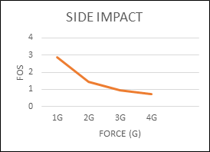
SIDE IMPACT
For the boundary conditions of the front impact test, the suspension mounting members on the chassis were fixed and force was applied on side face members of the chassis.
ASSUMPTIONS:
The vehicle undergoes a side collision with a stationary rigid object of infinite mass.
The acceleration (a) of the vehicle is 2G based on relative crash tests.
The impact time (t) of the collision is around 0.3 seconds.
Mass of the vehicle is 270 kgs. [120kg (Total vehicle) + 75x2 (Drivers)]
CALCULATIONS:
F = m x a ;
= 270 x (2G) =270 x 2 x 9.81
F = 5297.4 N
From the graph, at FOS 1.5 (approx) the value of force is 2G (approx)
The safe value of force is newtons is 5297.4 N for the 3rd iteration
V=G×g×t
V=2×9.81×0.3
V=5.886 m/s= 21.1896 kmph
Page 2.3

Slide 8
TORSIONAL (for chassis)
For the boundary conditions of the torsional test, the front suspension mounting members on the chassis were given forces in opposite directions and the rear suspension mounting points were kept fixed.
ASSUMPTIONS:
The vehicle undergoes a torsional force on its suspension members.
The acceleration (a) of the vehicle is 1G based on relative tests.
Mass of the vehicle is 270 kgs. [120kg (Total vehicle) + 75x2 (Drivers)]
CALCULATIONS:
F = m x a ;
= 270 x (1G) =270 x 1 x 9.81
F = 2648.7 N
Page 2.4

Slide 9
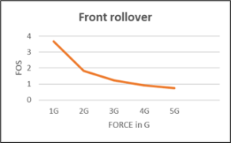
FRONT ROLLOVER
For the boundary conditions of the front rollover, the bottom members on the chassis were fixed and force was applied on topmost members of the chassis.
ASSUMPTIONS:
The vehicle has rolled over and is upside down on the ground
The acceleration (a) of the vehicle is 2G based on relative crash tests.
The impact time (t) of the collision is around 0.3 seconds.
Mass of the vehicle is 270 kgs. [120kg (Total vehicle) + 75x2 (Drivers)]
CALCULATIONS:
F = m x a ;
= 270 x (2G) =270 x 2 x 9.81
F = 5297.4 N
From the graph , at FOS 1.5 (approx) the value of force is 2.5G.
The value of force under which vehicle is deemed to be safe is 6,621.75 N.
Page 2.5

Slide 10
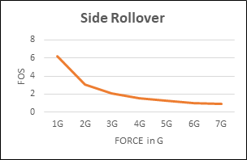
SIDE ROLLOVER
For the boundary conditions of the side rollover, members on one side of the chassis were fixed and force was applied on the other side.
ASSUMPTIONS:
The vehicle has rolled over with one side of the vehicle on the ground.
The acceleration (a) of the vehicle is 3G based on relative crash tests.
The impact time (t) of the collision is around 0.3 seconds.
Mass of the vehicle is 270 kgs. [120kg (Total vehicle) + 75x2 (Drivers)]
CALCULATIONS:
F = m x a ;
= 270 x (3G) =270 x 3 x 9.81
F = 7946.1 N
From the graph , at FOS 1.5, the value of force is 4.5 G (approx)
The value of force under which vehicle is deemed to be safe is 11,919.15 N.
Page 2.6

Slide 11
Hardpoint Load Calculation
APPROACH
An iterative approach was undertaken to find the Equivalent Stress, Strain , Total deformation, Factor of Safety, Fatigue life and FoS of the Hardpoints. The forces acting on all the hardpoints were calculated and it was also taken into consideration that fatigue loads act on the hardpoints.
The hardpoints considered were Front suspension mounting, Rear suspension mounting and mounting tabs
Page 2
Page 2.7

Slide 12
HARDPOINT (for Front Suspension)
For the boundary conditions of the front suspension hardpoint, the left suspension mounting tabs on the chassis were given forces and the right suspension mounting tabs were kept fixed.
ASSUMPTIONS:
The vehicle passes over a bump on only one of its wheels.
The ratio of weight distribution over the front axle to the rear axle is 46.6:53.4.
Mass of the vehicle is 270 kgs. [120kg (Total vehicle) + 75x2 (Drivers)]
CALCULATIONS:
The weight on the front axle is 125.82 kgs. This is divided into two parts because of two wheels. So, the weight on one wheel is 62.91 kgs.
Reaction force on each wheel is 617.14 N.
Page 2.8

Slide 13
HARDPOINT (for Rear Suspension)
For the boundary conditions of the rear suspension hardpoint, the rear suspension mounting tabs on the chassis were given forces and the front suspension mounting tabs were kept fixed.
ASSUMPTIONS:
The vehicle passes over a bump on only one of its wheels.
The ratio of weight distribution over the front axle to the rear axle is 46.6:53.4.
Mass of the vehicle is 270 kgs. [120kg (Total vehicle) + 75x2 (Drivers)]
CALCULATIONS:
The reaction force of 8000N is considered on rear suspension bracing. (under the critical conditions)
Considering two people weighing 115 kgs to be sitting on the seat, weighing 3 kgs each and a motor with its mounting to be 10 kgs, we get a total weight of 246kgs. Which is 2413.26 N of force.
But we have taken a maximum force of 8000N to be acting on the seat members for extreme conditions.
Page 2.9

Slide 14
HARDPOINT (for Mounting Tabs)
For the boundary conditions of the Mounting tabs, the hole in the mounting tabs where we insert the bolt is given a force and the curved surface were the mounting tab is welded to the frame is kept fixed.
ASSUMPTIONS:
The vehicle passes over a bump and load is transferred to the mounting tab.
The ratio of weight distribution over the front axle to the rear axle is 46.6:53.4.
Mass of the vehicle is 270 kgs. [120kg (Total vehicle) + 75x2 (Drivers)]
CALCULATIONS:
weight distribution of vehicle is 46.6:53.4
under critical conditions we performed analysis
weight of vehicle including drivers=340
The reaction force of 1500 is considered.
Reaction force = 340x (46.4/2) x100x10
~ 800N
Page 2.10

Slide 15
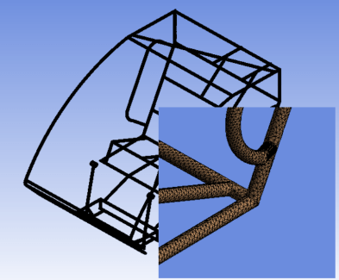
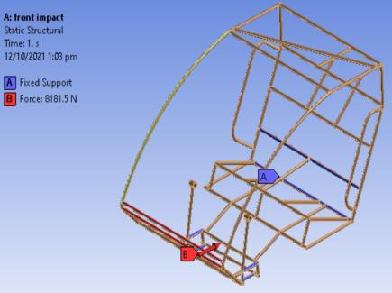
FE modelling and CAE Analysis of Frame
(Iteration 1)
FRONT IMPACT
Pre-Processing :
Meshed View
Loading and Boundary Conditions
Page 3.1

Slide 16
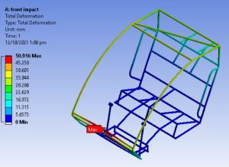
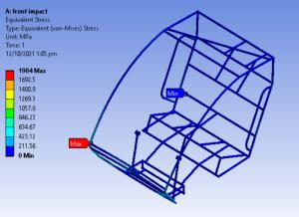
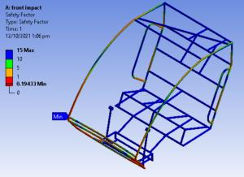
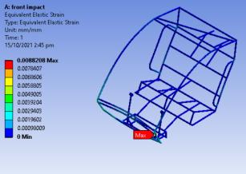
FRONT IMPACT - Iteration 1
Post-Processing
Total Deformation
Stress
Factor of Safety
Strain
Page 3.2

Slide 17
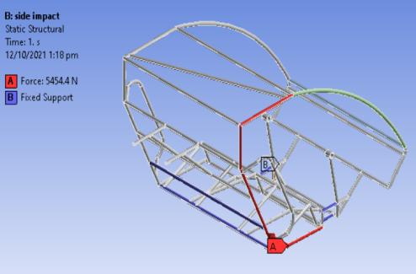
FE modelling and CAE Analysis of Frame
(Iteration 1)
SIDE IMPACT
Pre-Processing :
Meshed View
Loading and Boundary Conditions
Page 3.3

Slide 18
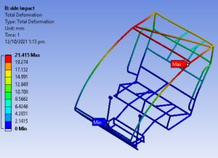
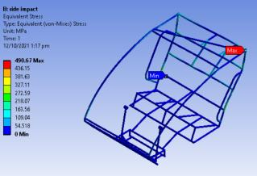
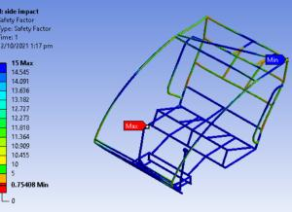
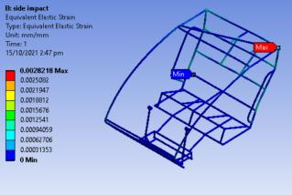
SIDE IMPACT - Iteration 1
Post-Processing
Total Deformation
Stress
Factor of Safety
Strain
Page 3.4

Slide 19
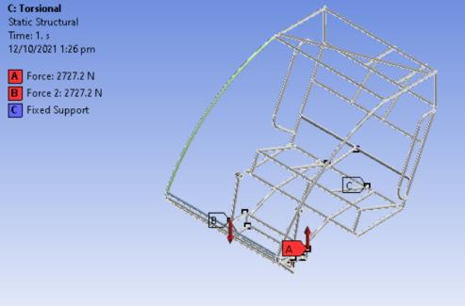
FE modelling and CAE Analysis of Frame
(Iteration 1)
TORSIONAL
Pre-Processing :
Meshed View
Loading and Boundary Conditions
Page 3.5

Slide 20
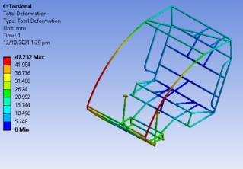
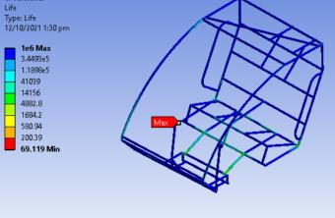
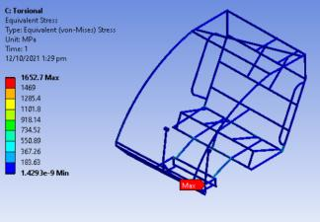
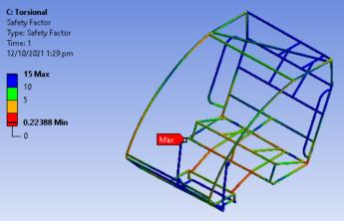
TORSIONAL - Iteration 1
Post-Processing :
Total Deformation
Fatigue Life
Stress
Factor of Safety
Page 3.6

Slide 21
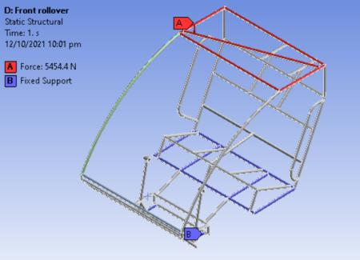
FE modelling and CAE Analysis of Frame
(Iteration 1)
FRONT ROLL-OVER
Pre-Processing :
Meshed View
Loading and Boundary Conditions
Page 3.7

Slide 22
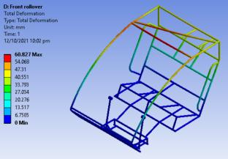
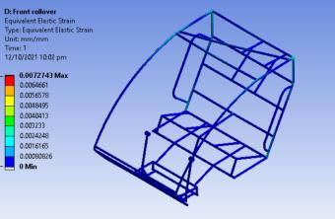
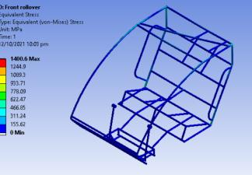
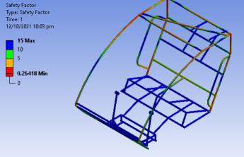
FRONT ROLL-OVER - Iteration 1
Post-Processing :
Total Deformation
Strain
Stress
Factor of Safety
Page 3.8

Slide 23
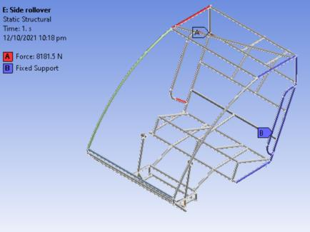
FE modelling and CAE Analysis of Frame
(Iteration 1)
SIDE ROLL-OVER
Pre-Processing :
Meshed View
Loading and Boundary Conditions
Page 3.9

Slide 24
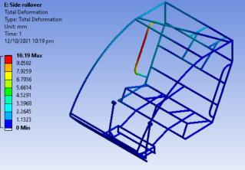
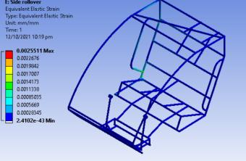
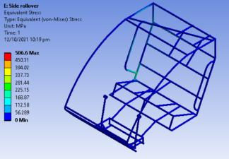
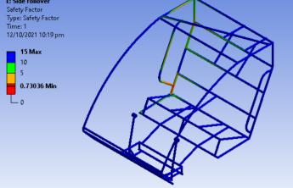
SIDE ROLL-OVER - Iteration 1
Post-Processing :
Total Deformation
Fatigue Life
Stress
Factor of Safety
Page 3.10

Slide 25
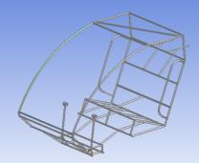
FE modelling and CAE Analysis of Frame
Parameters considered/Change details :
Material : AISI 1018
UTS : 370 MPa
Cross-Section : 1in O.D x 2mm Wall Thickness
Target Weight : 32 kgs
Design Weight : 37.64 kgs
Iteration-1
Test Run | Max Stress (MPa) |  | Max Deformation (mm) |  | Min FOS |  | Acceptability
 | Actual | Target | Actual | Target | Actual | Target | Yes/No
Frontal | 1904 | 175 | 50.916 | 10 | 0.19433 | 2.5 | No
Side | 264.06 | 300 | 11.618 | 20 | 1.5906 | 1.5 | Yes
Front Rollover | 1400.60 | 300 | 60.827 | 25 | 0.26418 | 1.5 | No
Side Rollover | 506.60 | 230 | 10.19 | 5 | 0.73036 | 3 | No
Torsion | 550.23 | 250 | 47.731 | 20 | 0.76331 | 1.5 | No
Justification of Accepting/ Rejecting Design: 1) Low Factor of Safety
2) Excess weight
Page 3.12

Slide 26
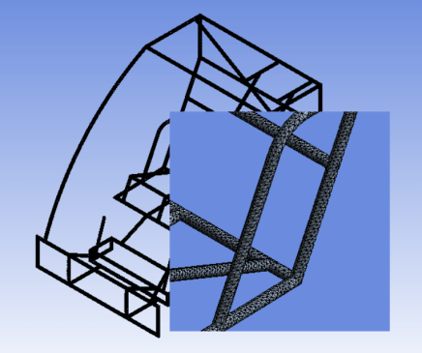
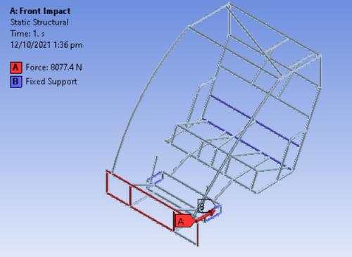
FE modelling and CAE Analysis of Frame
(Iteration 2)
FRONT IMPACT
Pre-Processing :
Meshed View
Loading and Boundary Conditions
Page 3.13

Slide 27
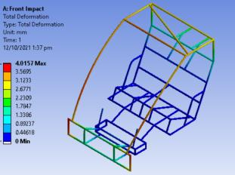
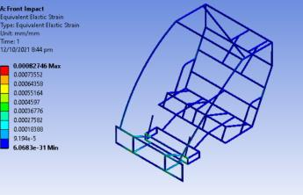
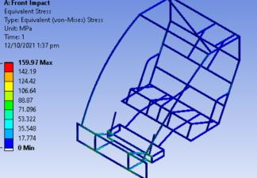
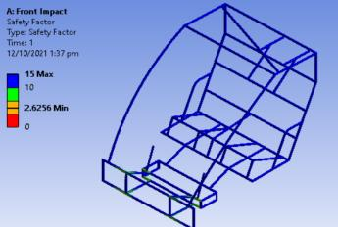
FRONT IMPACT - Iteration 2
Post-Processing :
Total Deformation
Strain
Stress
Factor of Safety
Page 3.14

Slide 28
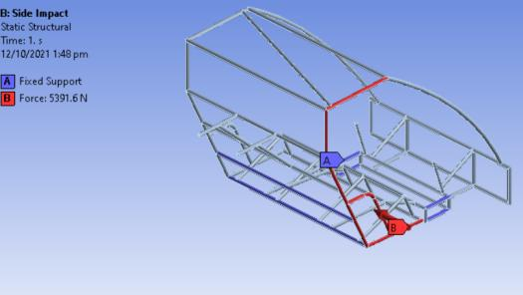
FE modelling and CAE Analysis of Frame
(Iteration 2)
SIDE IMPACT
Pre-Processing :
Meshed View
Loading and Boundary Conditions
Page 3.15

Slide 29
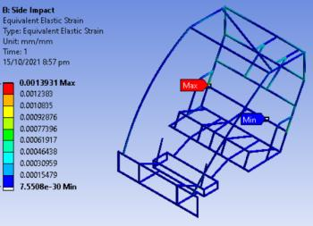



SIDE IMPACT- Iteration 2
Post-Processing :
Total Deformation
Strain
Stress
Factor of Safety
Page 3.16

Slide 30

FE modelling and CAE Analysis of Frame
(Iteration 2)
TORSIONAL
Pre-Processing :
Meshed View
Loading and Boundary Conditions
Page 3.17

Slide 31




TORSIONAL- Iteration 2
Post-Processing :
Total Deformation
Fatigue Life
Stress
Factor of Safety
Page 3.18

Slide 32

FE modelling and CAE Analysis of Frame
(Iteration 2)
SIDE ROLL-OVER
Pre-Processing :
Meshed View
Loading and Boundary Conditions
Page 3.19

Slide 33




SIDE ROLL-OVER - Iteration 1
Post-Processing :
Total Deformation
Strain
Stress
Factor of Safety
Page 3.20

Slide 34

FE modelling and CAE Analysis of Frame
(Iteration 1)
FRONT ROLL-OVER
Pre-Processing :
Meshed View
Loading and Boundary Conditions
Page 3.21

Slide 35




FRONT ROLL-OVER - Iteration 1
Post-Processing :
Total Deformation
Strain
Stress
Factor of Safety
Page 3.22

Slide 36

FE modelling and CAE Analysis of Frame
Parameters considered/Change details :
Material : AISI 1018
UTS : 370 MPa
Cross-Section : 1in O.D x 2mm Wall Thickness
Target Weight : 32 kgs
Design Weight : 35.06 kgs
Parameters considered/Change details :
Material : AISI 1018
UTS :
Cross-Section : 1in O.D x 2mm Wall Thickness
Target Weight : 32 kgs
Design Weight : 35 kgs
Iteration-2
Test Run | Max Stress (Unit) |  | Max Deformation (Unit) |  | Min FOS |  | Acceptability
 | Actual | Target | Actual | Target | Actual | Target | Yes/No
Frontal | 159.97 | 175 | 4.0157 | 10 | 2.6256 | 2.5 | Yes
Side | 264.06 | 300 | 11.618 | 20 | 1.5906 | 1.5 | Yes
Front Rollover | 293.67 | 300 | 19.276 | 25 | 1.4302 | 1.5 | No
Side Rollover | 22.633 | 230 | 0.4636 | 5 | 9.8304 | 3 | Yes
Torsion | 550.23 | 250 | 47.731 | 20 | 0.76331 | 1.5 | No
Justification of Accepting/ Rejecting Design: 1) Excess weight
2) Low FoS
Page 3.23

Slide 37


FE modelling and CAE Analysis of Frame
(Iteration 3)
FRONT IMPACT
Pre-Processing :
Boundary and Loading Conditions
Meshed View
Page 3.24

Slide 38




FRONT IMPACT - Iteration 3
Post-Processing :
Total Deformation
Strain
Stress
Factor of Safety
Page 3.25

Slide 39

FE modelling and CAE Analysis of Frame
(Iteration 3)
SIDE IMPACT
Pre-Processing :
Meshed View
Boundary and Loading Conditions
Page 3.26

Slide 40




SIDE IMPACT- Iteration 3
Post-Processing :
Total Deformation
Strain
Stress
Factor of Safety
Page 3.27

Slide 41

FE modelling and CAE Analysis of Frame
(Iteration 3)
TORSIONAL
Pre-Processing :
Meshed View
Boundary and Loading Conditions
Page 3.28

Slide 42




TORSIONAL - Iteration 3
Post-Processing :
Total Deformation
Fatigue Life
Stress
Factor of Safety
Page 3.29

Slide 43

FE modelling and CAE Analysis of Frame
(Iteration 3)
FRONT ROLL-OVER
Pre-Processing :
Meshed View
Boundary and Loading Conditions
Page 3.30

Slide 44




FRONT ROLL-OVER - Iteration 3
Post-Processing :
Total Deformation
Strain
Stress
Factor of Safety
Page 3.31

Slide 45

FE modelling and CAE Analysis of Frame
(Iteration 3)
SIDE ROLL-OVER
Pre-Processing :
Meshed View
Boundary and Loading Conditions
Page 3.32

Slide 46




SIDE ROLL-OVER - Iteration 3
Post-Processing :
Total Deformation
Strain
Stress
Factor of Safety
Page 3.33

Slide 47

FE modelling and CAE Analysis of Frame
Parameters considered/Change details :
Material : AISI 4130
UTS :
Cross-Section : 1in O.D x 1.75mm Wall Thickness
Target Weight : 32 kgs
Design Weight : 31.8 kgs
Parameters considered/Change details :
Material : AISI 4130
UTS : 460 MPa
Cross-Section : 1in O.D x 1.75mm Wall Thickness
Target Weight : 36 kgs
Design Weight : 35.63 kgs
Iteration-3
Test Run | Max Stress (Unit) |  | Max Deformation (Unit) |  | Min FOS |  | Acceptability
 | Actual | Target | Actual | Target | Actual | Target | Yes/No
Frontal | 169.46 | 175 | 3.7335 | 10 | 2.567 | 2.5 | Yes
Side | 297.73 | 300 | 17.527 | 20 | 1.561 | 1.5 | Yes
Front Rollover | 236.64 | 300 | 20.321 | 25 | 1.838 | 1.5 | Yes
Side Rollover | 70.033 | 230 | 3.4326 | 5 | 6.211 | 3 | Yes
Torsion | 213.88 | 250 | 18.989 | 20 | 1.636 | 1.5 | Yes
Justification of Accepting: 1) Lightweight
2) Good factor of safety
Page 3.34

Slide 48

FRONT SUSPENSION (Iteration 1)
Pre - processing
Loading and Boundary Conditions
Page 4.1

Slide 49




FRONT SUSPENSION (Iteration 1)
Post- processing:
Total Deformation
FOS (static)
Stress
FOS (fatigue)
Page 4.2

Slide 50

FRONT SUSPENSION (Iteration 2)
Pre - processing
Loading and Boundary Conditions
Page 4.3

Slide 51




FRONT SUSPENSION (Iteration 2)
Post- processing:
Total Deformation
FOS (static)
Stress
FOS (fatigue)
Page 4.4

Slide 52

FE modelling and CAE Analysis of Hard Points
Location-1: Front Suspension Mounting Points
Only 3 bracing members
An extra bracing member has been added
Iteration number | Max Stress (Unit) |  | Max Deformation (Unit) |  | Min FOS |  | Acceptability
 | Actual | Target | Actual | Target | Actual | Target | Yes/No
1 | 633.09 | 290 | 23.272 | 10 | 0.6871 | 1.5 | No
2 | 211.97 | 290 | 6.1471 | 10 | 2.0522 | 1.5 | Yes
Justification : As the results show, the bracing member was critical for a proper result.
Page 4.5

Slide 53

MOUNTING TABS
Pre-Processing
Meshed view,Loading and Boundary Conditions
Page 4.6

Slide 54




MOUNTING TABS
Post- processing
Total Deformation
FOS (static)
Stress
FOS (fatigue)
Page 4.7

Slide 55


REAR SUSPENSION HARDPOINT (Iteration 1)
Pre- processing
Meshed View
Loading and Boundary Conditions
Page 4.3
Page 4.8

Slide 56




REAR SUSPENSION HARDPOINT (Iteration 1)
Post-processing
Total Deformation
FOS (static)
Stress
FOS (fatigue)
Page 4.9

Slide 57

REAR SUSPENSION HARDPOINT (Iteration 2)
Pre- processing
Meshed View
Loading and Boundary Conditions
Page 4.3
Page 4.10

Slide 58




REAR SUSPENSION HARDPOINT (Iteration 2)
Post-processing
Total Deformation
FOS (static)
Stress
FOS (fatigue)
Page 4.11

Slide 59


FE modelling and CAE Analysis of Hard Points
Location-2: Rear Suspension
No extra bracing member
An extra bracing member was added
Iteration number | Max Stress (MPa) |  | Max Deformation (mm) |  | Min FOS |  | Acceptability
 | Actual | Target | Actual | Target | Actual | Target | Yes/No
1 | 2984.2 | 290 | 96.005 | 5 | 0.1458 | 1.5 | No
2 | 264.57 | 290 | 2.6672 | 5 | 1.6442 | 1.5 | Yes
Justification : As the results show, the bracing member was critical for a proper result.
Page 4.12

Slide 60
Summary of results:
An iterative approach has been followed for designing of the frame and hardpoints.
Results have been noted at each step of the design process and a lot of effort has been put into making the vehicle durable while simultaneously trying to make it lightweight.
The first iteration was like a building block towards achieving an ideal result. It was designed keeping in mind all the rules mentioned in the rulebook and relatively less attention was given to its analysis. The results were thoroughly examined and a new chassis was built keeping this as a reference.
The second iteration was designed with safety as the main focus. We did get good results for the second iteration frame but it was a little too heavy for our liking.
The third iteration was mainly a refinement of the second iteration with weight reduction being the main motive and also to further improve the results. Redundant members of the chassis were removed to reduce weight.
Page 5.1

Slide 61
Modifications from the first iteration to the second iteration:
The main flaw of the first iteration was with the front impact.
The curved member took all the impact and hence a lot of stress was built up there. To counter this flaw, the front of the vehicle was modified to take the force and distribute it on a large area. Additionally, two bracing members were provided to the front to absorb more energy.
Additionally, the side protection members were brought in plane with the side members in order to obtain better results for side impact and side rollover.
*Please refer to the images of the frames in appendix 1
Page 5.2

Slide 62
Modifications from the second iteration to the third iteration:
The main flaw of the second iteration was with the weight of the frame.
Although the results of the second iteration frame were good, it was heavy.
In order to reduce the weight, we have used AISI 4130 for the frame. The yield strength and corrosion resistance of AISI 4130 is better than AISI 1018. Thus, we were able to obtain better results with AISI 4130.
Additionally, the side protection members were brought in plane with the side members in order to obtain better results for side impact and side rollover.
*Please refer to the images of the frames in appendix 1
Page 5.3

Slide 63
MATERIAL SPECIFICATIONS
Properties of AISI 4130 compared to AISI 1018
PARAMETER | AISI 4130
Density (kg/m²) | 7850
Ultimate tensile strength (MPa) | 600
Yield strength | 460
Young modulus (GPa) | 215
Poisson’s ratio | 0.29
PARAMETER | AISI 1018
Density (kg/m²) | 7870
Ultimate tensile strength (MPa) | 440
Yield strength | 365
Young modulus (GPa) | 205
Poisson’s ratio | 0.29
Page 5.4

Slide 64


MATERIAL SPECIFICATIONS
SN curve of AISI 4130
Page 5.5

Slide 65






APPENDIX 1
Comparison between first and second iteration (Above- 1st iteration, Below- 2nd iteration)
Page
5.6

Slide 66



APPENDIX 1
Comparison between first and second iteration (Above- 2nd iteration, Below- 3rd iteration)
Page 5.7

